Slide 1
Gold Price Forecasting Application
Year: 2023-2024

Slide 2

Project Supervisor
DR. Safi Ibrahim
Eng. Aya Magdy

Slide 3


Team Members
20-01085
20-01155
20-00688
20-01892
Mohamed Glal Abdelazeem
Mohamed Atef Ahmed
Mahmoud Abdelkarim Khalaf
20-01243
20-01310
20-01672
Shady Ashraf Lahzay
Mohamed Sayed Mahmoud
Dalia Fathy Gadalrab
Mohamed Taha Ali

Slide 4
Agenda
1
Introduction
Literature Review
(Related Work)
2
5
Conclusion
Prototype, Tools
And Technologies
Framework
3
4
System Methodology

Slide 5


Introduction
In a world where financial markets are increasingly influenced by intricate data and complex factors, the ability to predict the price of gold has become a critical endeavor. Gold, often referred to as the "ultimate currency," stands as a symbol of wealth, security, and stability in the face of economic uncertainties.

Slide 6

Literature Review
We collected 35 research papers and selected the six best research papers

Slide 7
Literature Review (Related Work)
paper 1
Year
2022
Accuracy
98%
Dataset
Date: Monthly price data for the period of January 2008 to May 2018.
Name
Gold Price Prediction
Algorithm
Random Forest
Regression

Slide 8
Literature Review (Related Work)
paper 2
Year
2022
Accuracy
98.87%
Name
ENSEMBLE REGRESSION-BASED
GOLD PRICE (XAU/USD)
Dataset
Gold Price Data
Algorithm
Random Forest
Regressor

Slide 9
Literature Review (Related Work)
paper 3
Year
2021
Accuracy
97%
Dataset
gold price with the XGBoost algorithm and SHAP
Name
Forecasting gold price with the XGBoost algorithm and SHAP
Algorithm
XGBOOST

Slide 10
Literature Review (Related Work)
paper 4
Year
2020
Accuracy
98%
Dataset
monthly gold prices from March 1988 to December 2016
Name
Assessing the Performance of Machine Learning Methods in Forecasting Gold Prices
Algorithm
Random Forest

Slide 11
Literature Review (Related Work)
paper 5
Year
2019
Accuracy
98.9%
Dataset
gold price
Name
Gold Price Prediction using Ensemble based Machine Learning Techniques
Algorithm
Random Forest
Regression

Slide 12
Literature Review (Related Work)
paper 6
Year
2019
Accuracy
98.76%
Dataset
Data collected from (http:/www.etf.com/GLD)
Name
Gold Price Prediction using Machine Learning
Algorithm
Linear Regression

Slide 13



Languages
We used colab to make the project with python language and in python we used this libraries (Scikitlearn ,Pandas ,NumPy ,TensorFlow ,Karse ,Matplotlib , Seaborn) and we used dart language in flutter to make the application
Python
Dart

Slide 14




Framework
we used colab with python language to make the code and used figma to make the prototype and flutter and android studios to make application to predict the gold price
Figma
Flutter
Google colab
Android studio

Slide 15

System Methodology
Algorithms used
Random Forest Regressor
3
1
XGBOOST
2
Linear Regression

Slide 16
System Methodology
Abstract about algorithm
XGBOOST
is a machine learning method based on decision trees. It's designed to optimize and enhance the performance of decision tree algorithms. Key characteristics of

Slide 17
System Methodology
Abstract about algorithm
Linear Regression
is an algorithm of machine learning, based on supervised learning. It does the role of regression. Regression is a process using independent predictors to model a target value.

Slide 18
System Methodology
Abstract about algorithm
Random Forest Regression
Random Forest is a machine learning algorithm that is used for both classification and regression tasks. It is a type of ensemble learning algorithm, which means that it combines the predictions of multiple machine learning models to produce a more accurate prediction.

Slide 19
System Methodology
Training Models
1- XGBOOST
2- Linear Regression

Slide 20
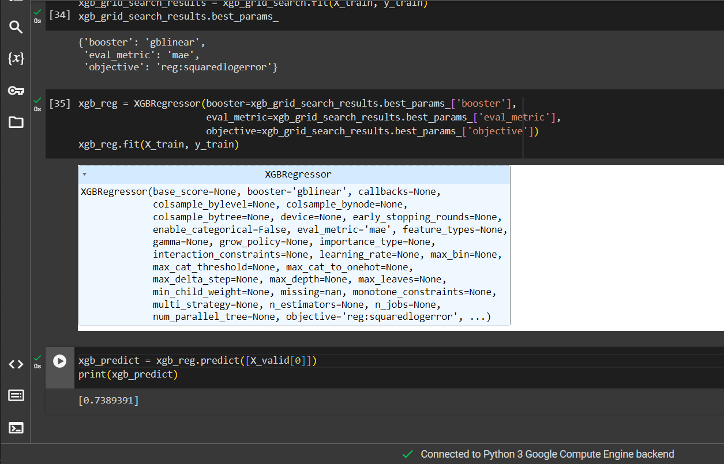
System Methodology
1- XGBOOST
“we developed an XGBoost algorithm that achieved an accuracy of 73%."

Slide 21
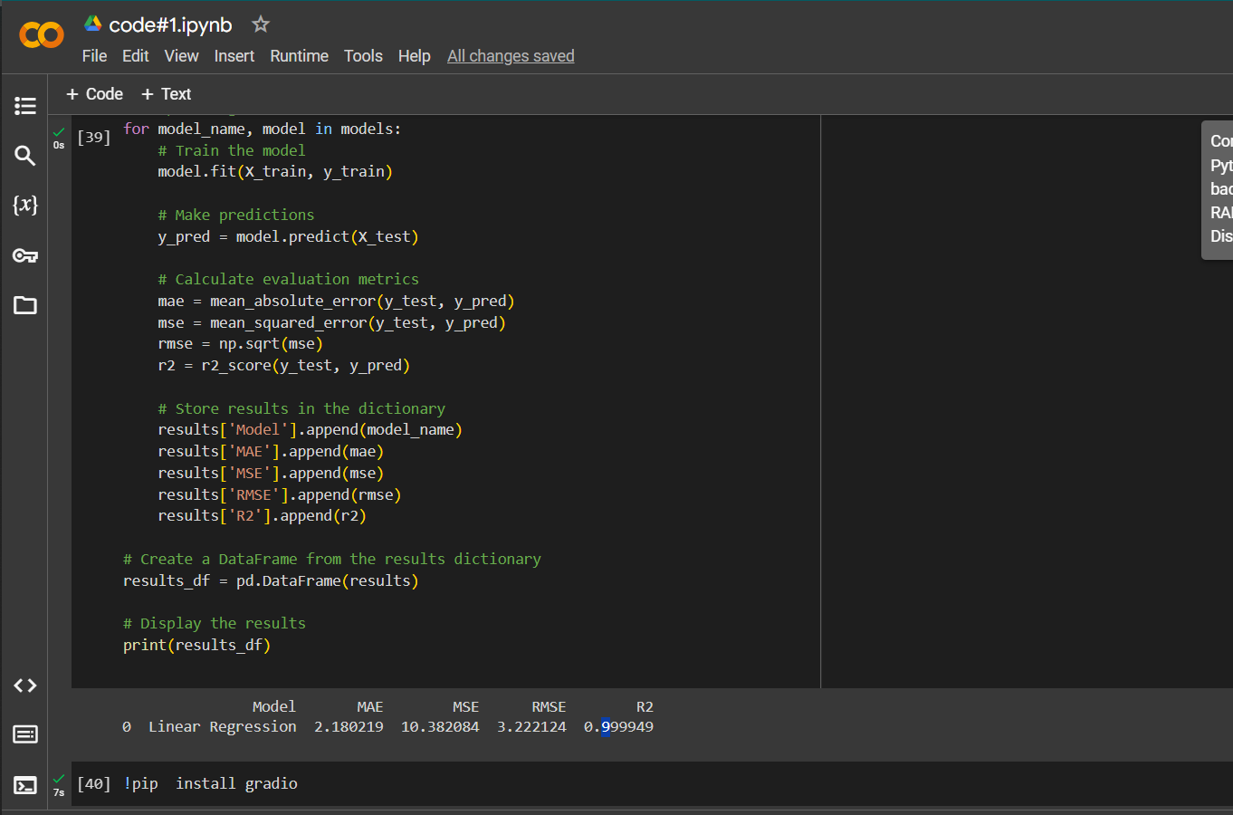
System Methodology
2-Linear Regression
“we developed Linear Regressing algorithm that achieved an accuracy of 99%."

Slide 22
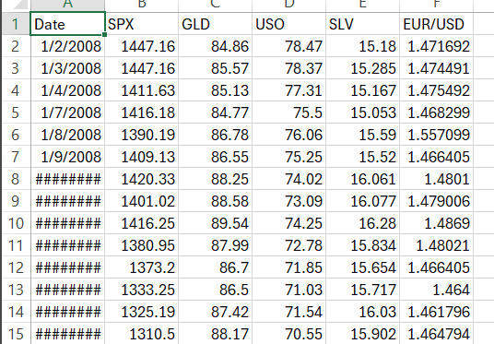
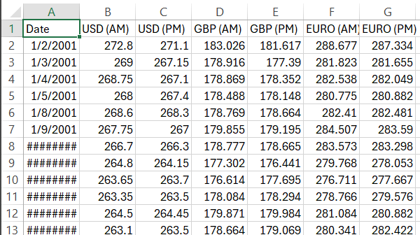
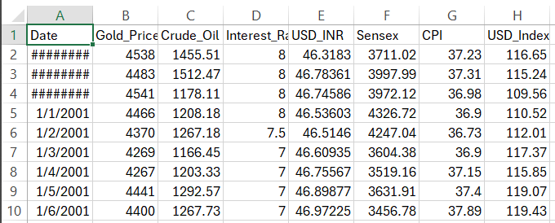
System Methodology
XGBOOST
Linear Regression
accuracy of 73%
All data sets used for training the models
accuracy of 99%

Slide 23
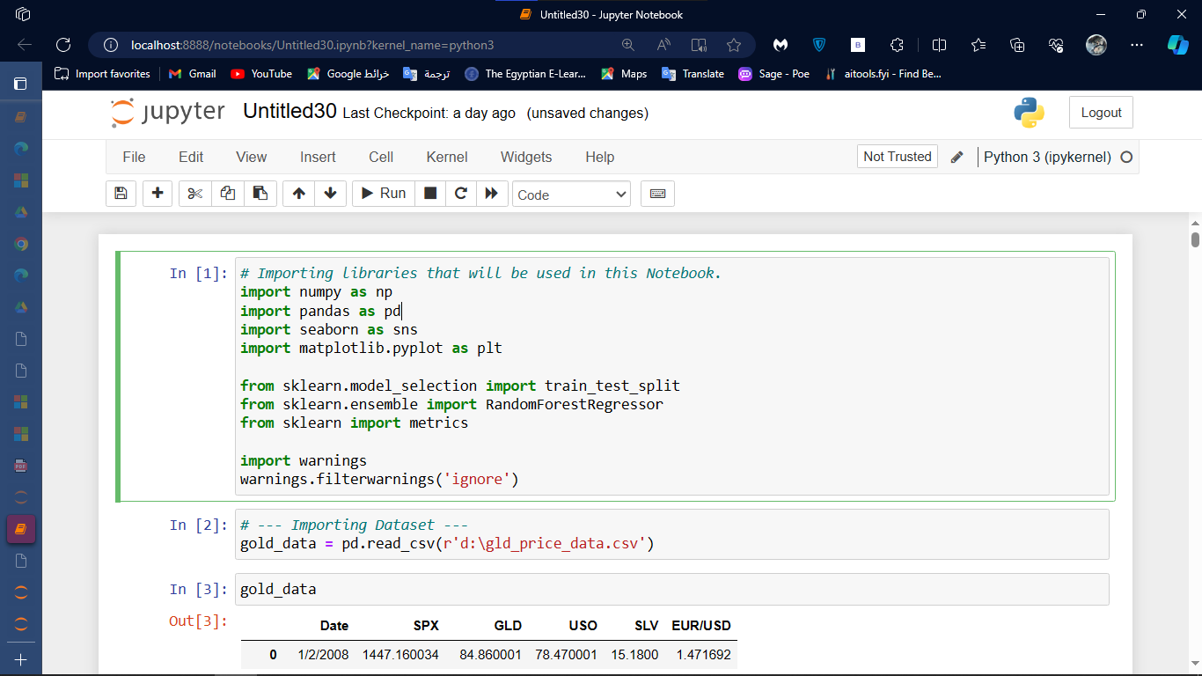
System Methodology
This Steps to show how built this model by Random Forest Regression
1- Import libraries
Scikitlearn
Pandas
NumPy
TensorFlow
Karse
Matplotlib
Seaborn

Slide 24
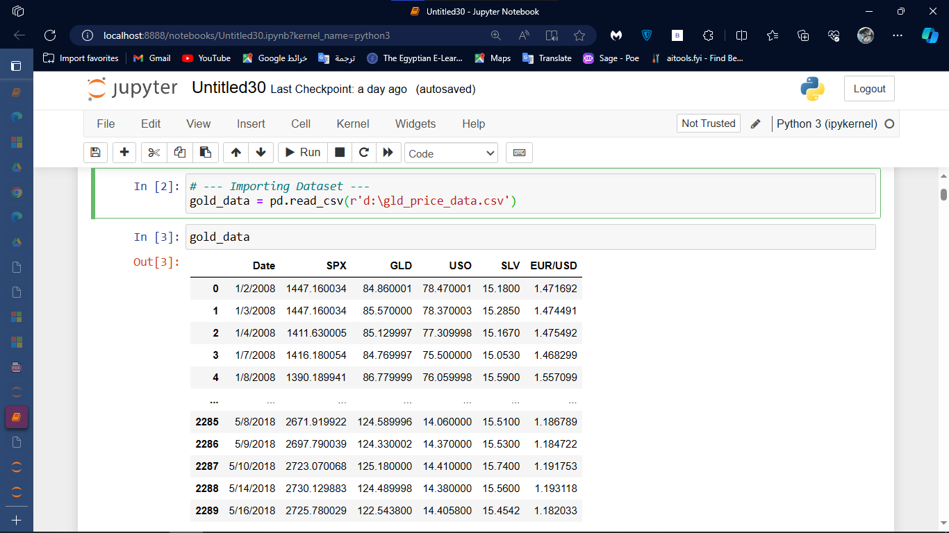
System Methodology
1- Import libraries
Scikitlearn
Pandas
NumPy
TensorFlow
Karse
Matplotlib
Seaborn

Slide 25
System Methodology
2- import dataset and read
Use Pandas

Slide 26
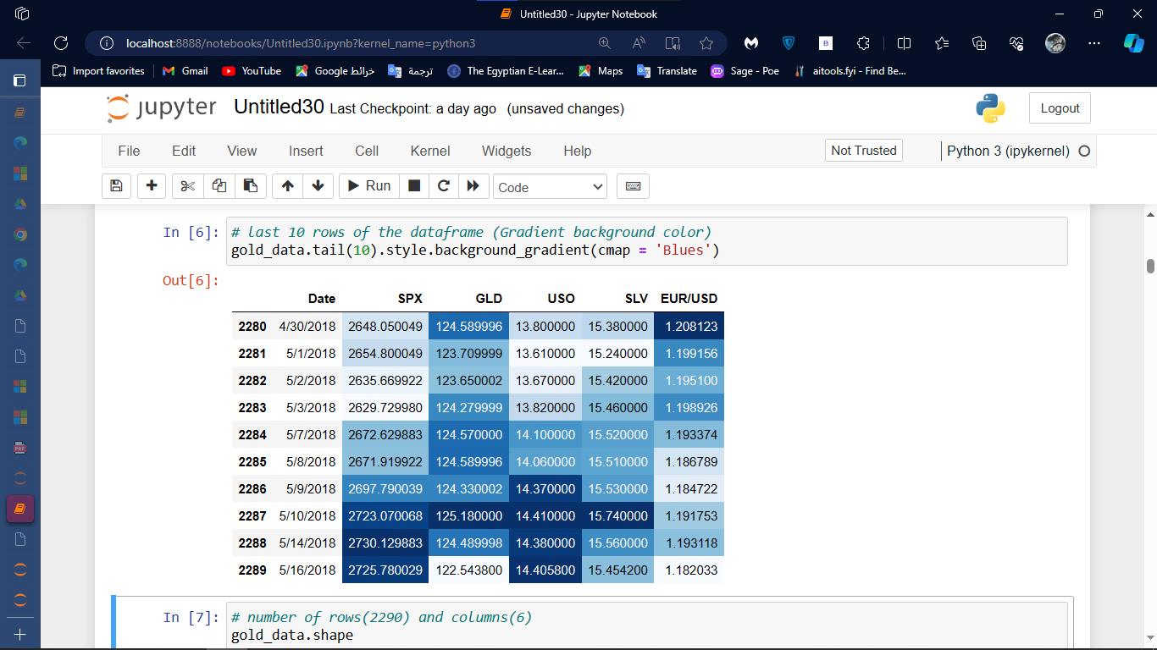
System Methodology
3- visualization
Use Seaborn
Use Matplotlib

Slide 27
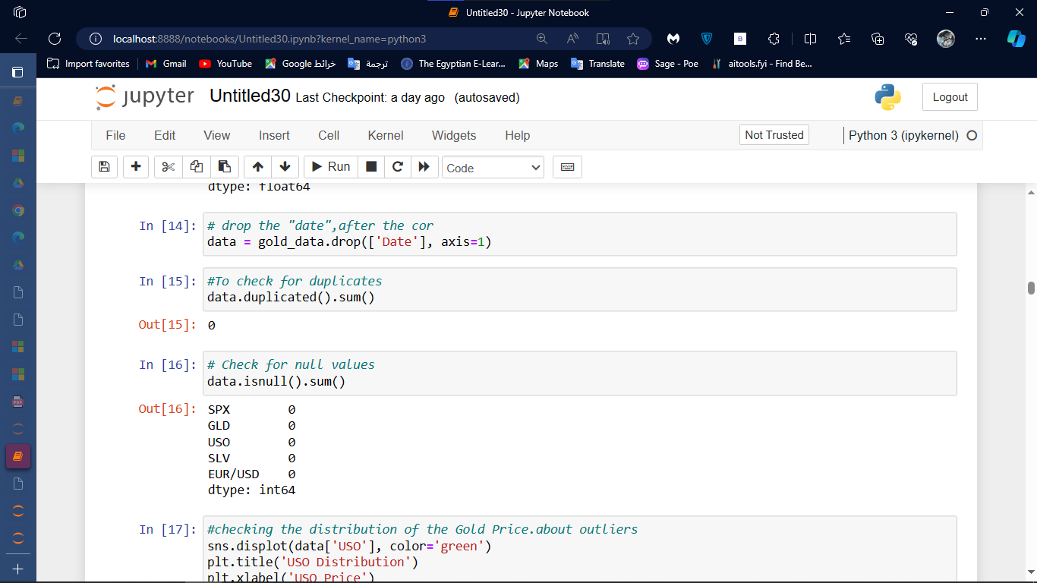
System Methodology
4- cleaning and preprocessing by use
handling missing values

Slide 28
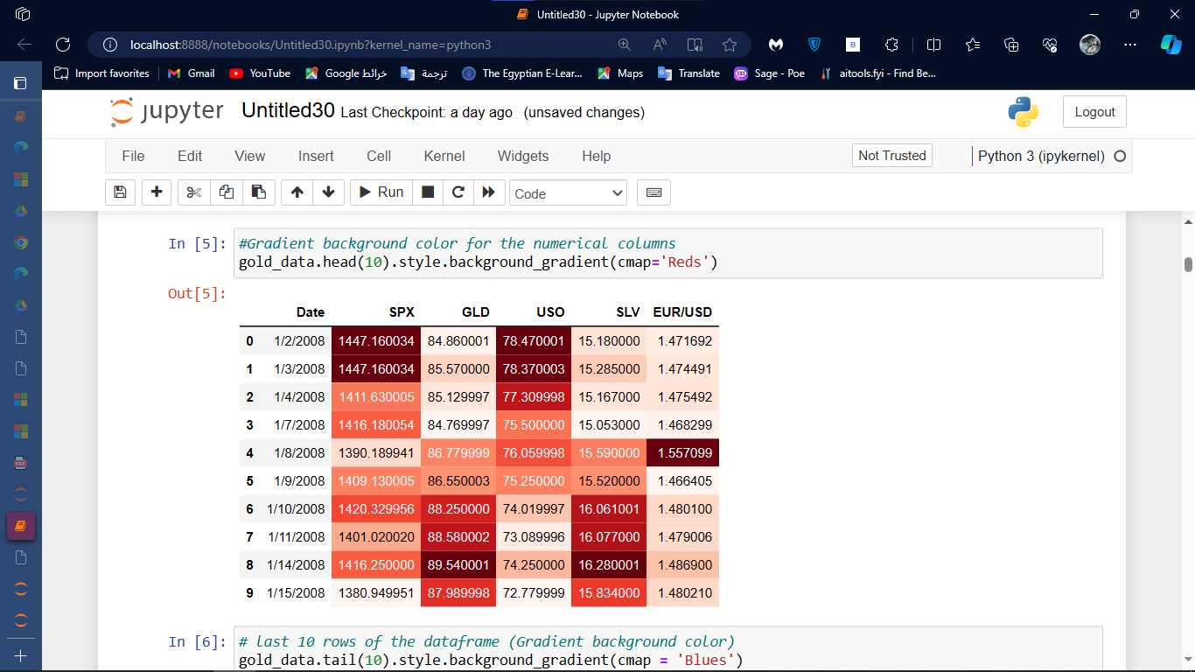
System Methodology
5- visualization after cleaning
Use Seaborn
Use Matplotlib

Slide 29
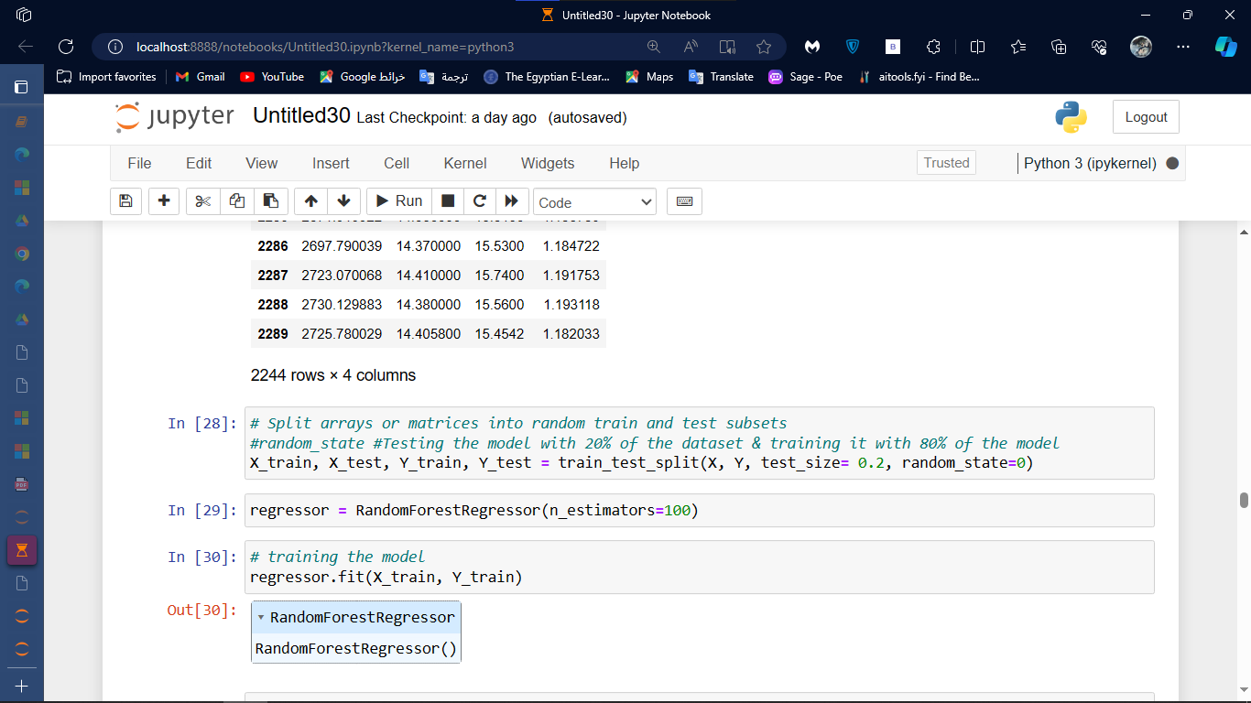
System Methodology
6- split dataset
Scikitlearn
In this step, more than one ratio was used, but we discovered that the best ratio for dividing the data is
80% for training
20% for testing

Slide 30
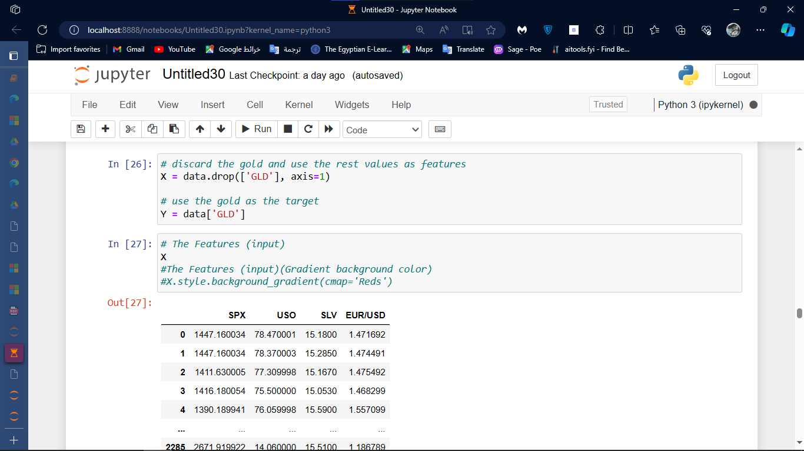
System Methodology
7- feature selection
Spx
Uso
Slv
ERU/USD

Slide 31
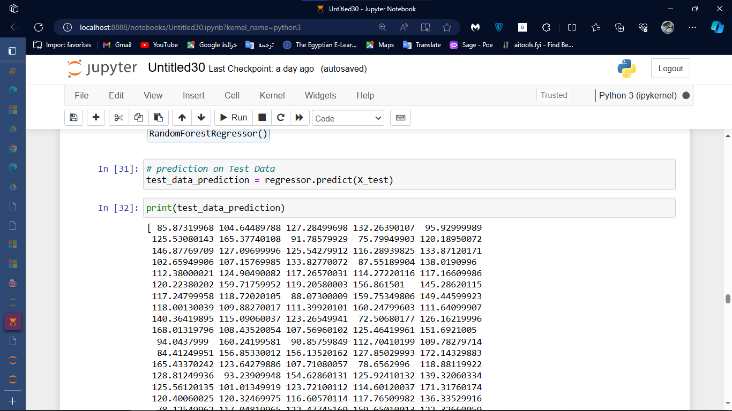
System Methodology
Step eight: predict of test data

Slide 32
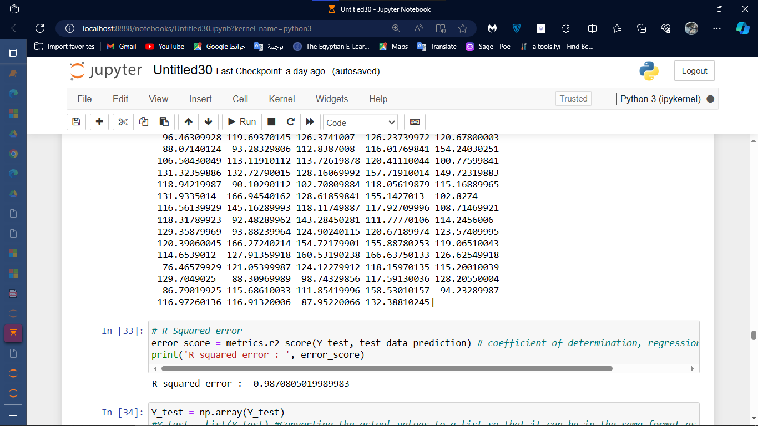
System Methodology
Step night valuation criteria used to assess the performance of model

Slide 33
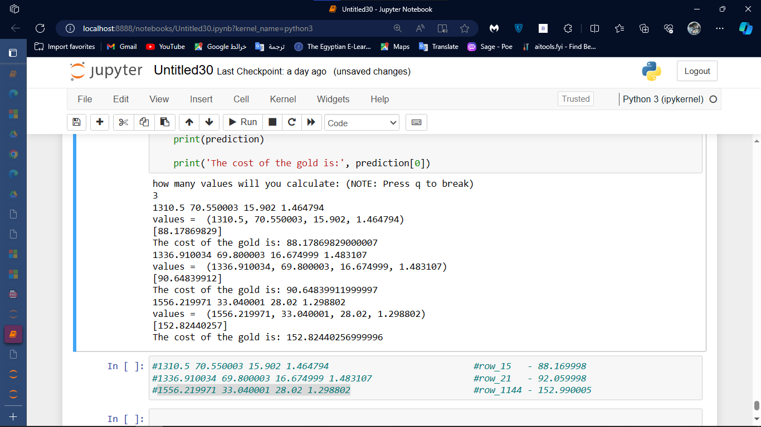
System Methodology
Step ten built the model

Slide 34
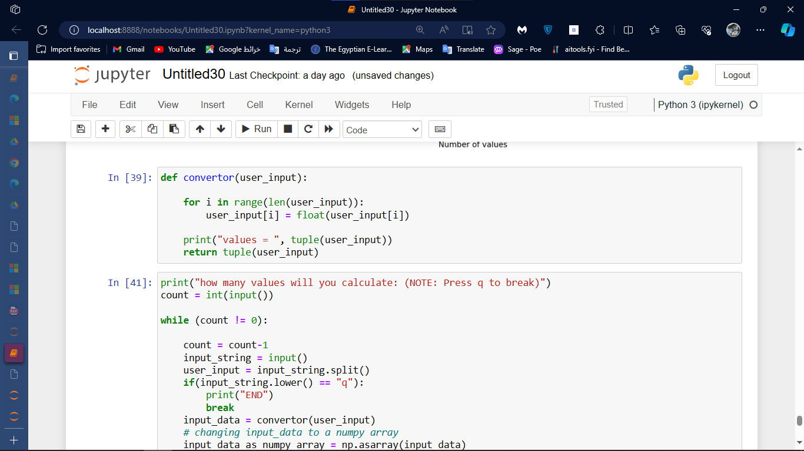
System Methodology
Step ten built the model

Slide 35
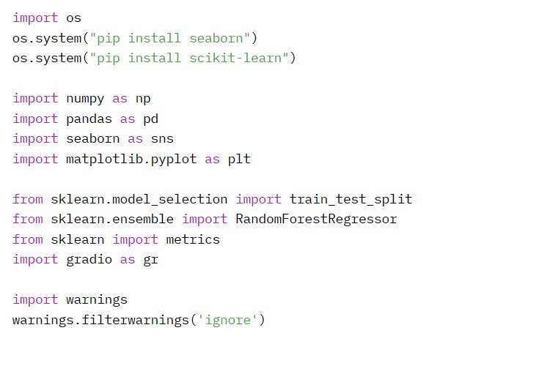
System Methodology
Final step make integration with app by gradio

Slide 36
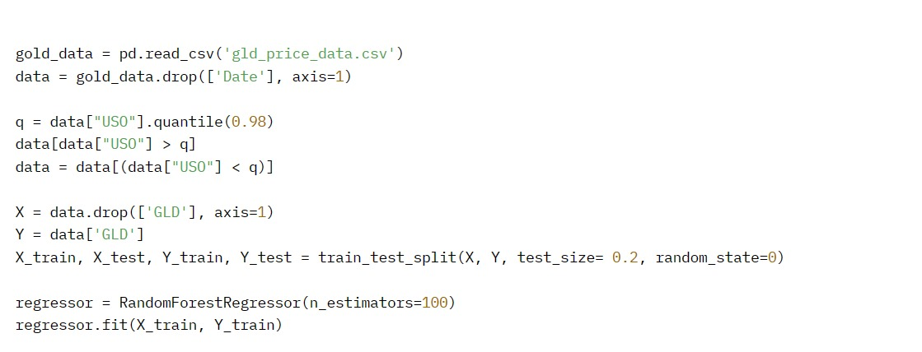
System Methodology
Final step make integration with app by gradio

Slide 37
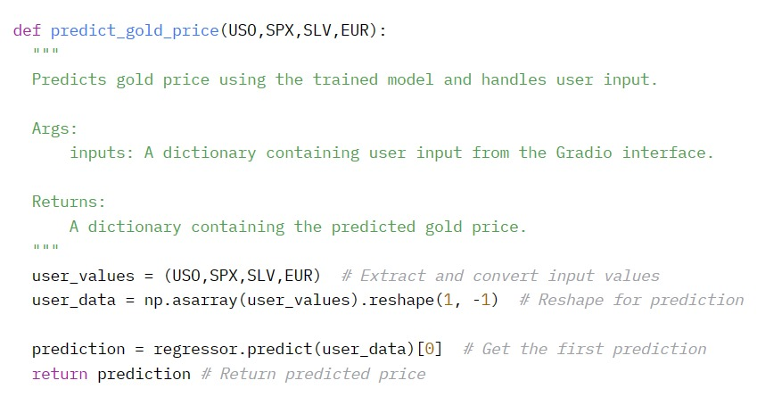
System Methodology
Final step make integration with app by gradio

Slide 38
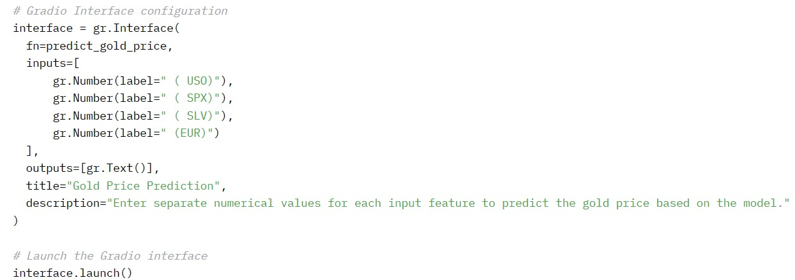
System Methodology
Final step make integration with app by gradio

Slide 39
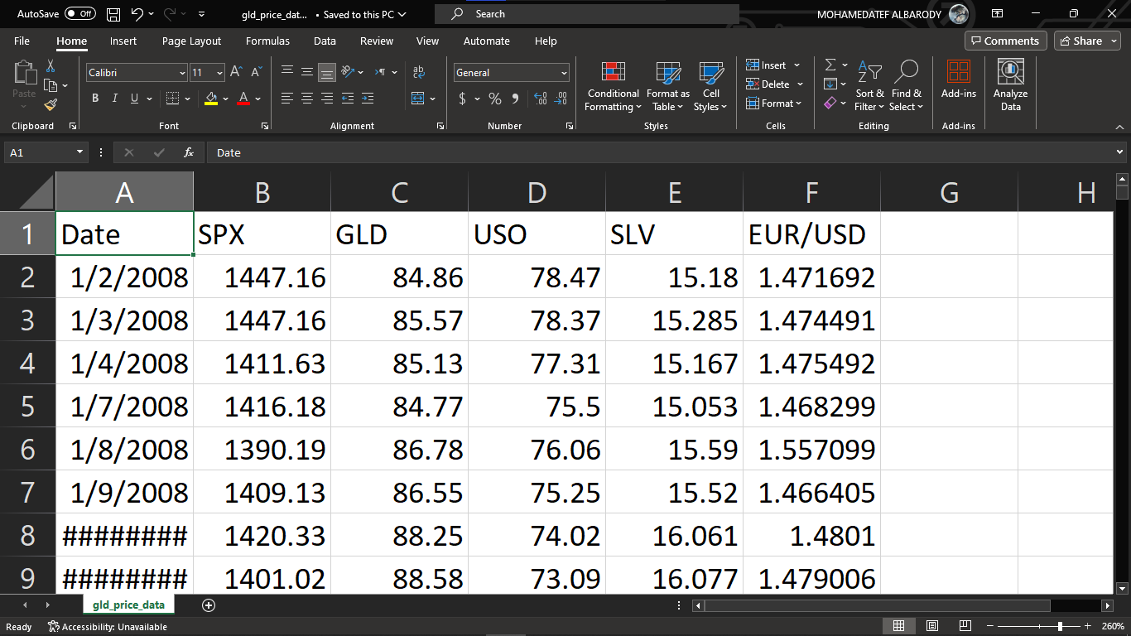
System Methodology
This is a dataset used in model by Random Forest Regression
About dataset
1- Data consists of various GLD (gold) prices for several days in the period of 10 years [Date-MM/DD/YYYY].
2- SPX - The Standard and Poor's 500, or simply the S&P 500, is a stock market index tracking the performance of 500 large companies listed on stock exchanges in the United States.
3- The United States oil Fund (USO)
4- Silver Trust (SLV)
5- EUR/USD - The Currency Pair EUR/USD is the shortened term for the euro against U.S.
6- United States (USD). The value of the EUR/USD pair is quoted as 1 euro per x U.S. dollars.
The number of columns= 6
The number of rows= 2290

Slide 40
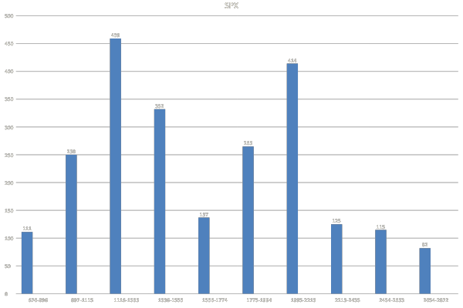
Data Explorer[SPX]

Slide 41
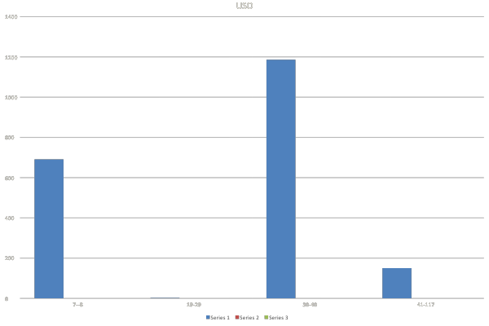
Data Explorer[USO]

Slide 42
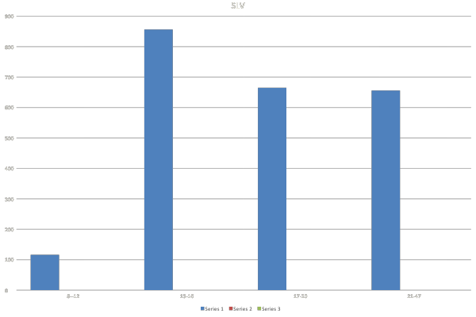
Data Explorer[SLV]

Slide 43
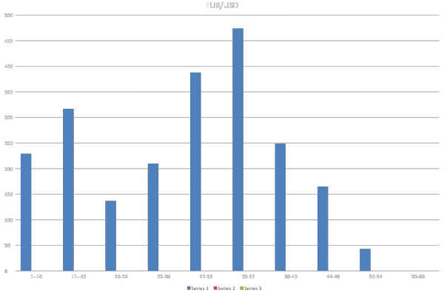
Data Explorer[EUR/USD]

Slide 44
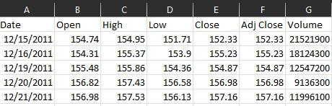
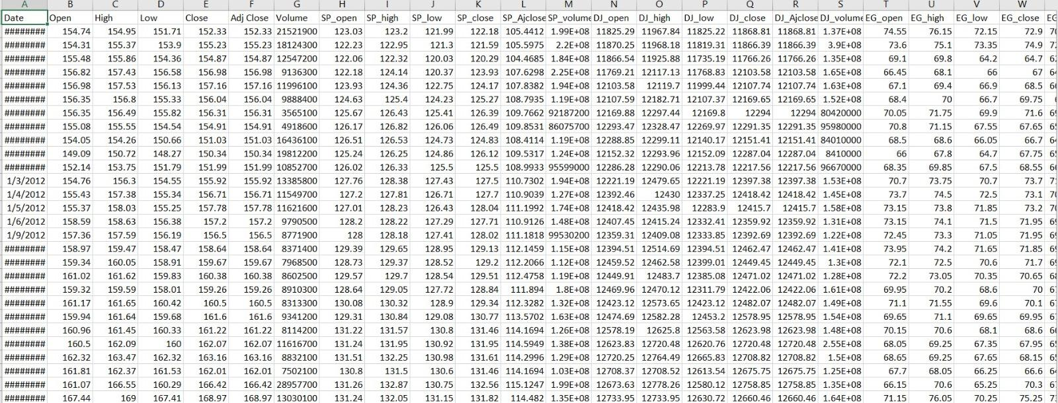
All Dataset Used
Link
Gold Price
Gold Price Prediction Dataset
Link
Gold Price Prediction Dataset

Slide 45
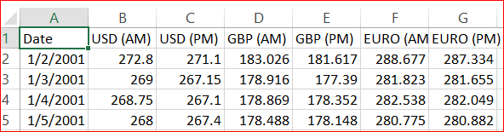
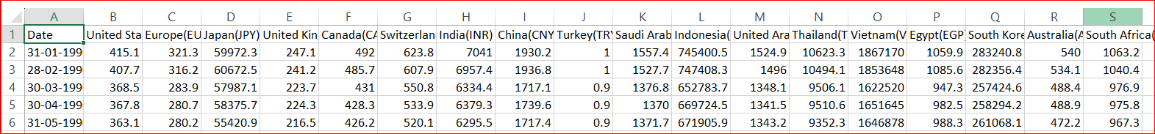
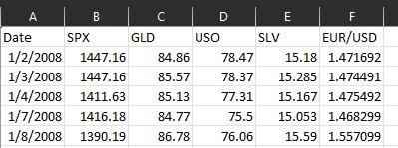
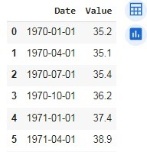
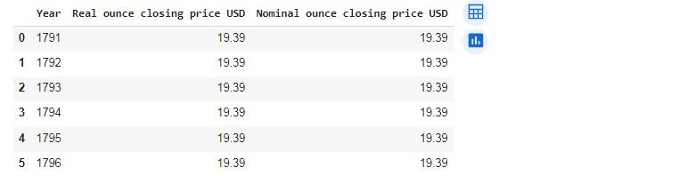
Link
Link
Link
All Dataset Used
Link
Link
Gold Price Prediction Dataset

Slide 46

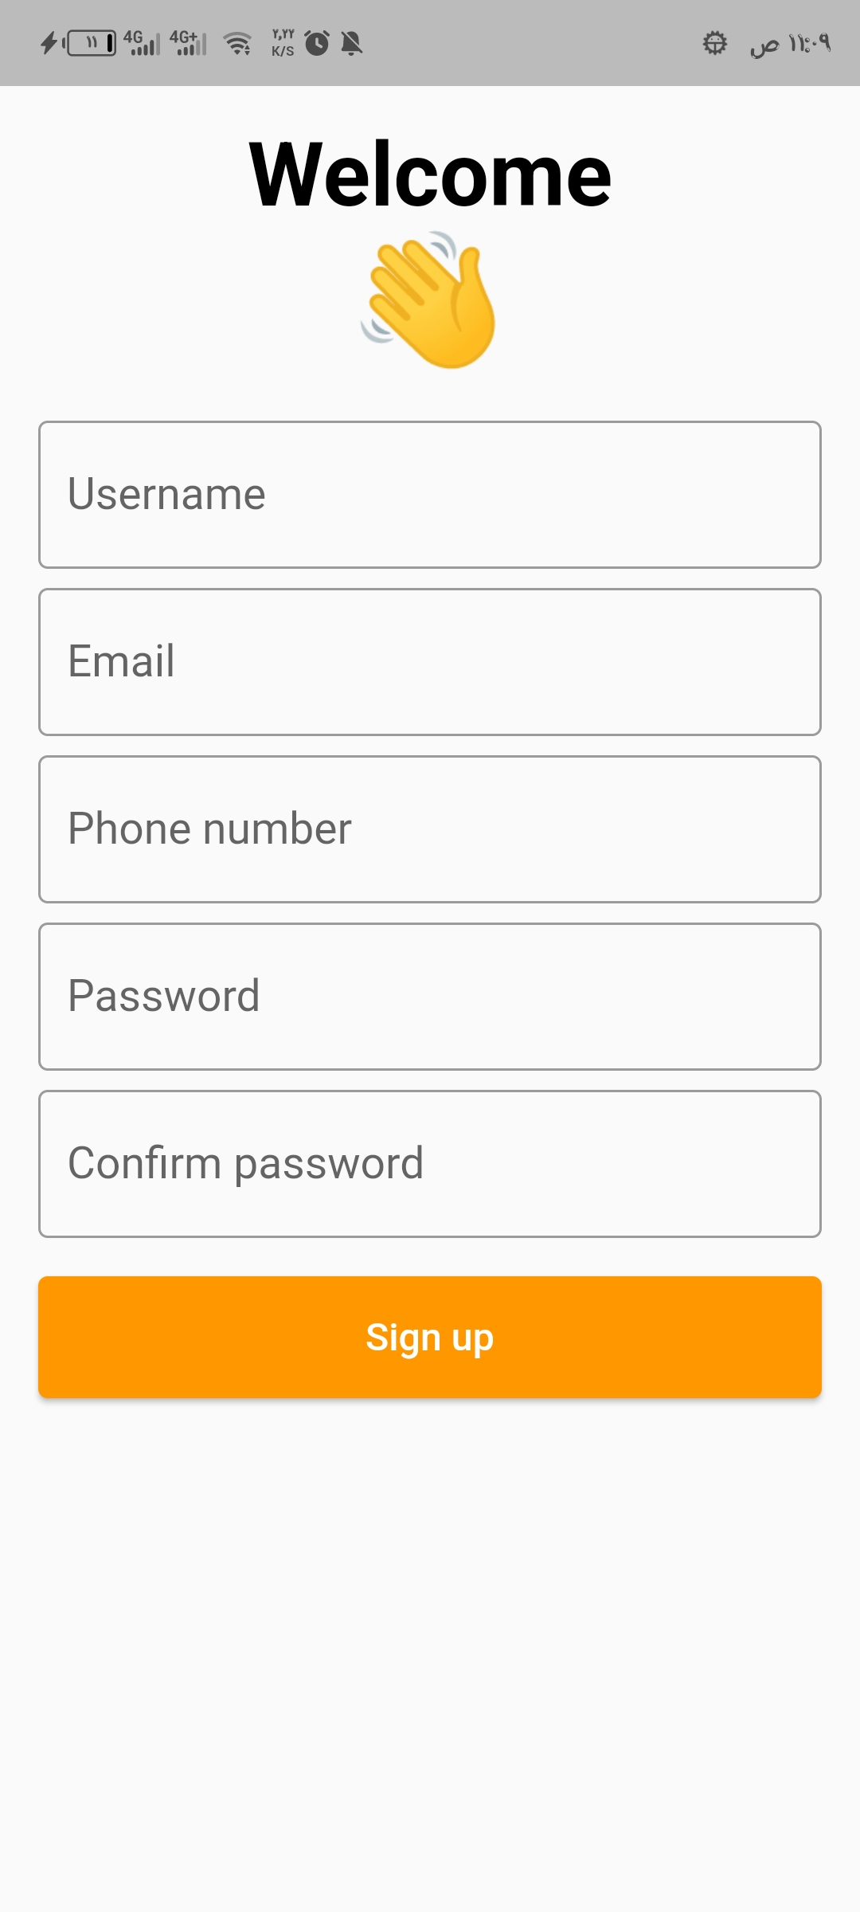
Prototype

Slide 47
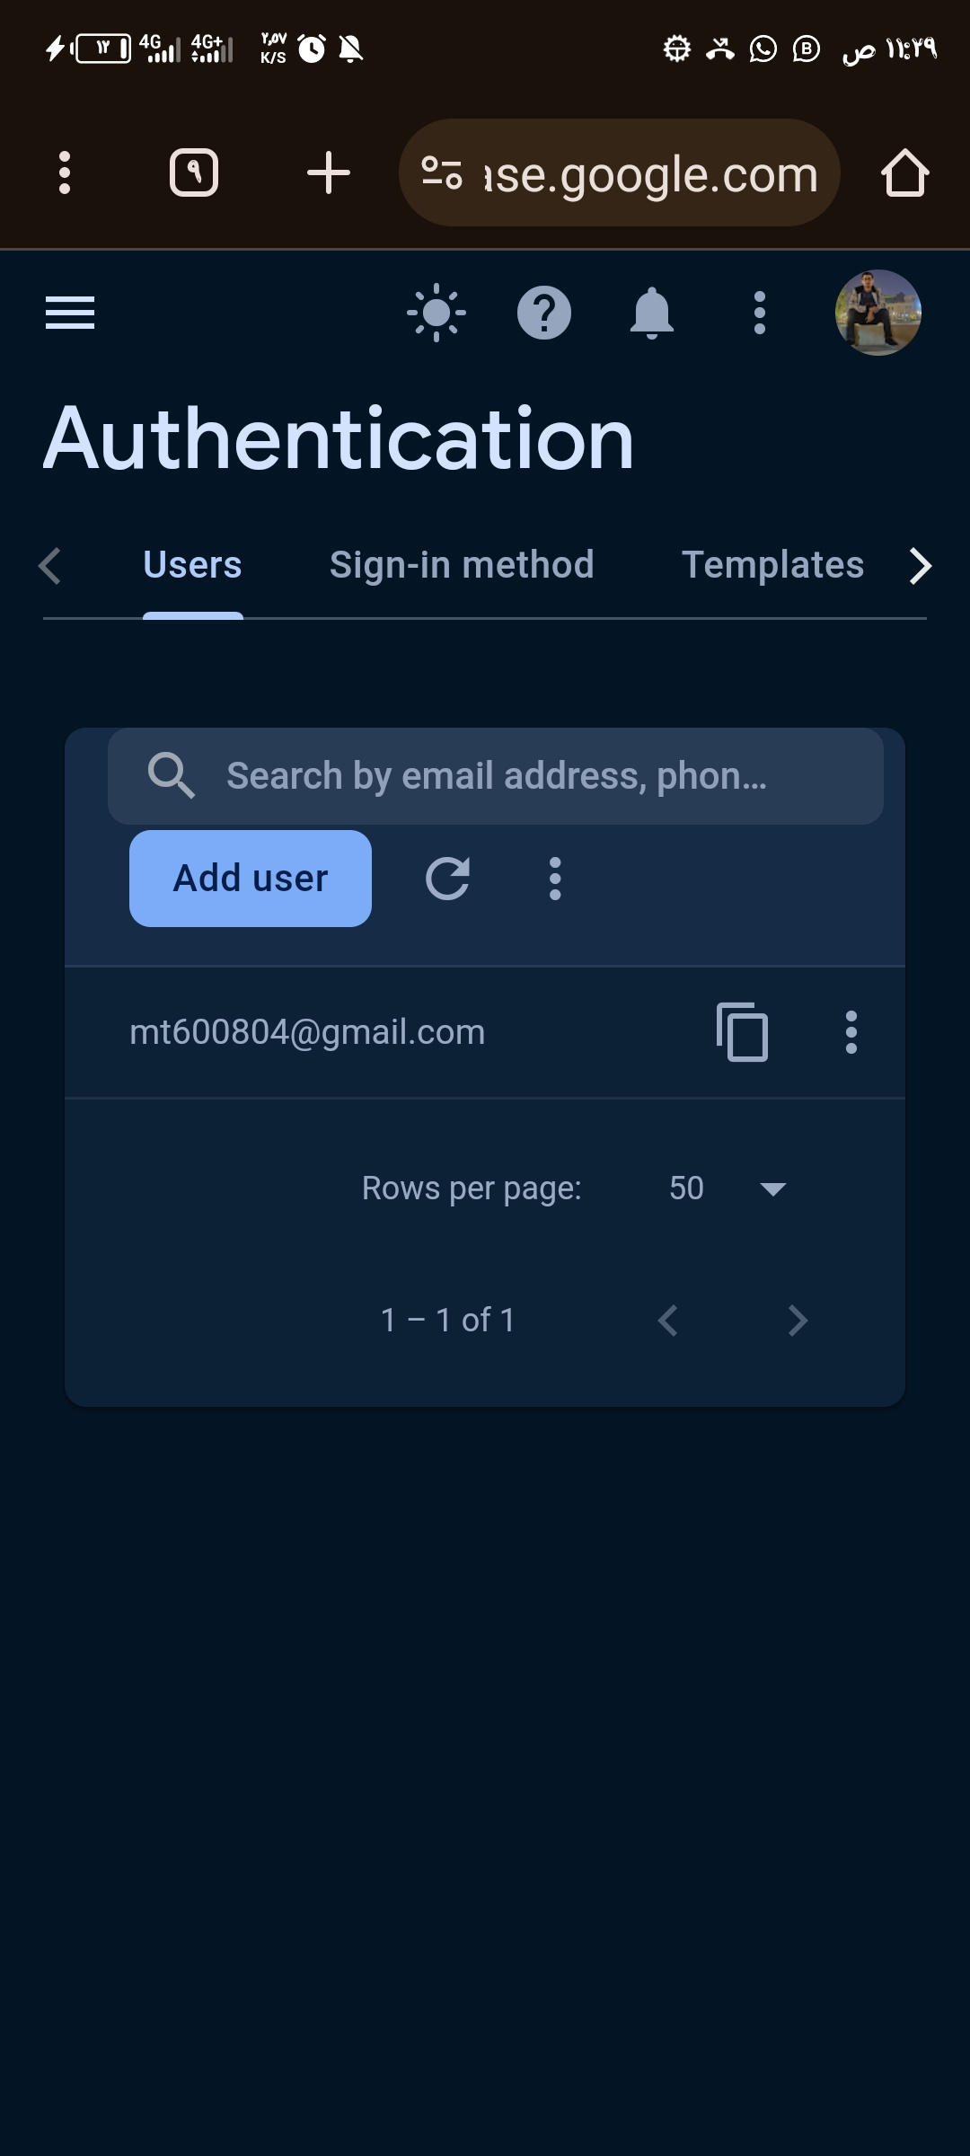
Prototype

Slide 48
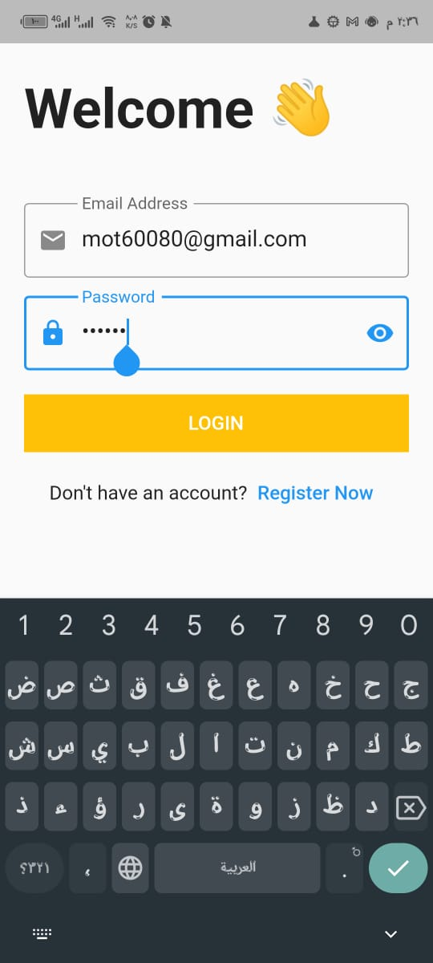
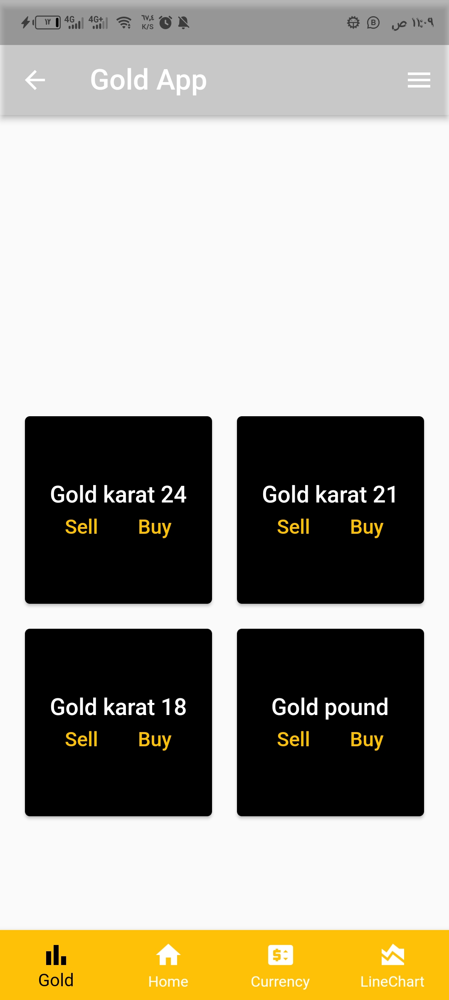
Prototype

Slide 49
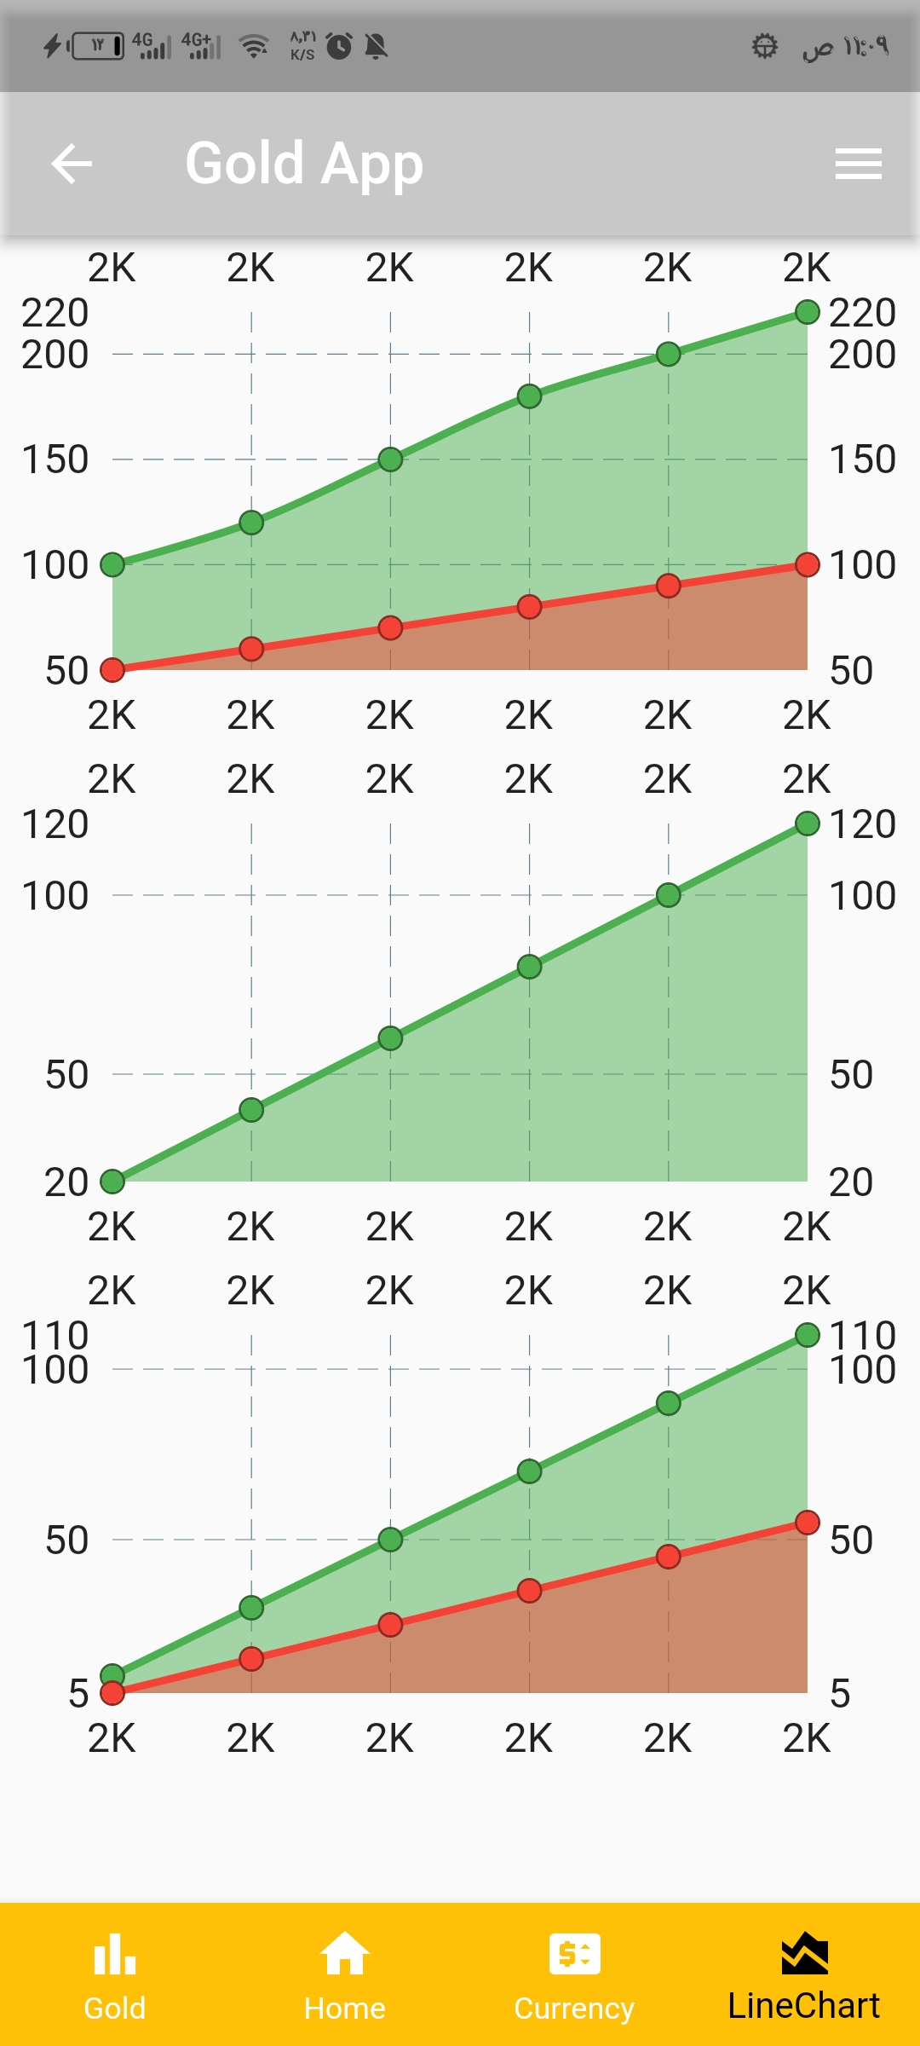
Prototype

Slide 50

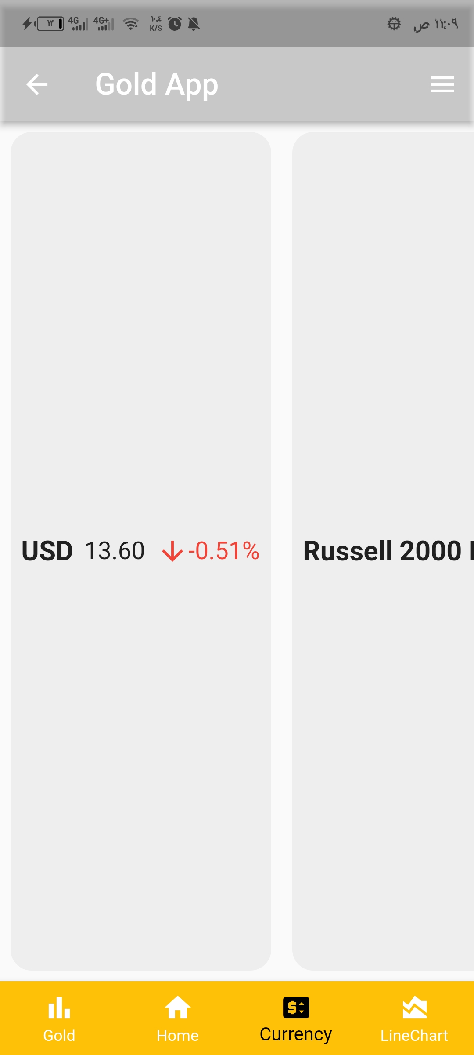
Prototype

Slide 51
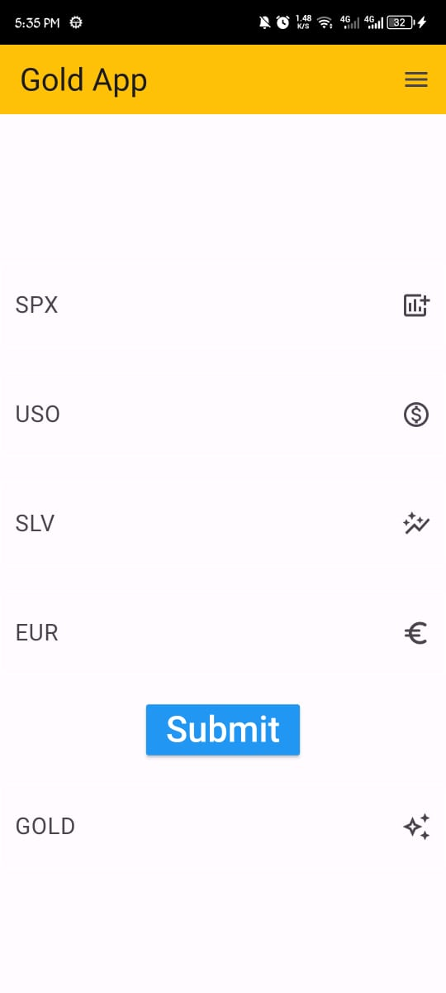
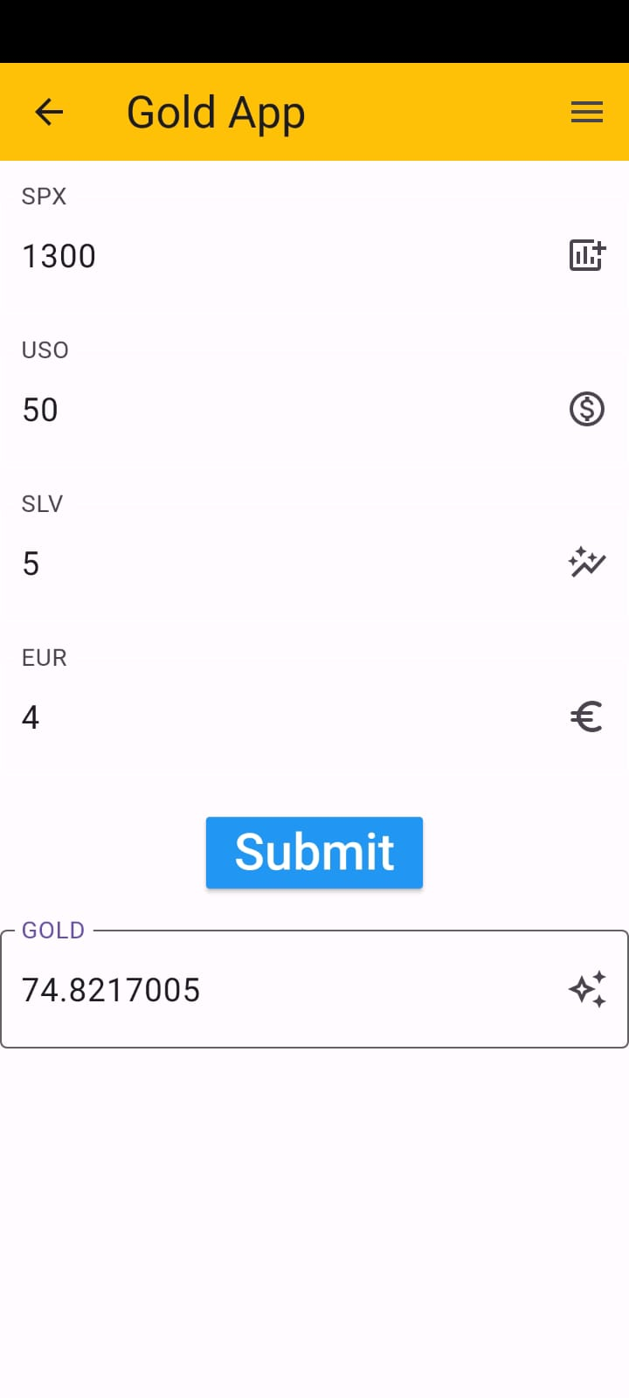
Prototype

Slide 52

Business model

Slide 53

Why business model
The business model for a gold price forecasting app hinges on delivering accurate, timely, and valuable insights to a broad range of users. By leveraging a freemium model, targeted advertising, and strategic partnerships, the app can generate multiple revenue streams while maintaining high user engagement and satisfaction. Continuous improvement in technology and customer relations will be key to sustaining growth and competitive advantage.

Slide 54
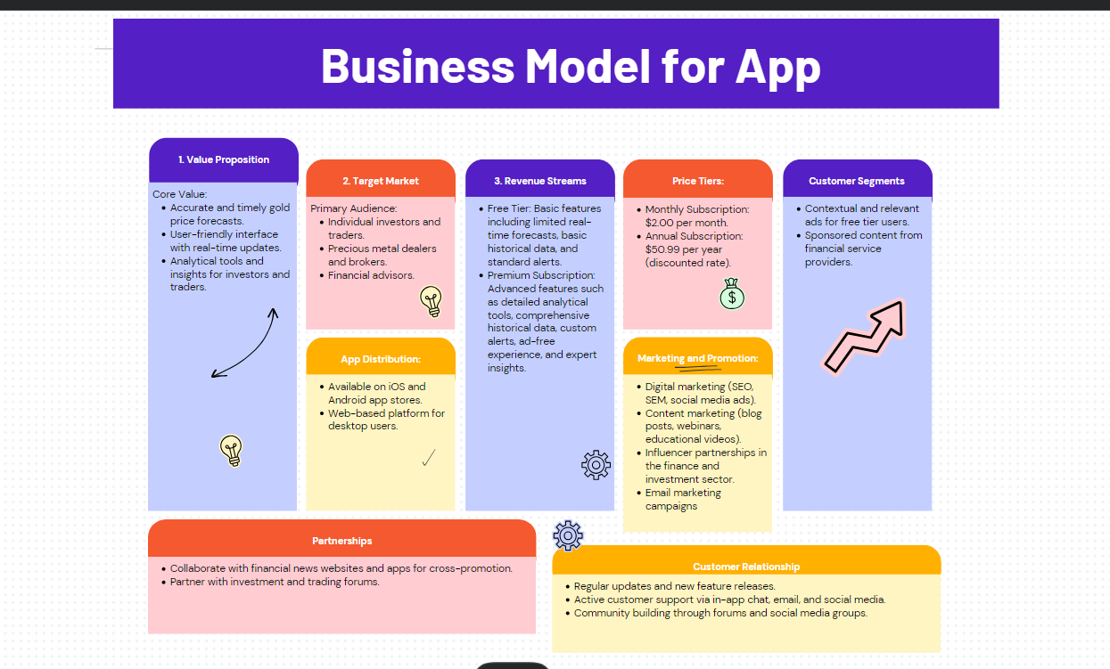

Slide 55
Date | Duration | Start | End | Requirements
Task 1 from 1/7/2023 To1/8/2023 | 30 | 7/1/2023 | 8/1/2023 | Studying courses in machine learning and deep learning
Task 2 from 1/8/2023 To1/9/2023 | 30 | 8/1/2023 | 9/1/2023 | Identifying project ideas, discussing them, and choosing the best ideas
Task 3 from 1/9/2023 To15/9/2023 | 15 | 9/1/2023 | 9/15/2023 | Defining the project idea and compiling research papers through the Google Scholar and studying them
Task 4 from 15/9/2023 To30/9/2023 | 15 | 9/15/2023 | 9/30/2023 | Choose the best research papers for the idea and the highest accuracy, build a prototype, and choose the latest Dataset through Kaggle
Task 5 from 1/10/2023 To1/11/2023 | 30 | 10/1/2023 | 11/1/2023 | Determine the contents of each research paper, including the name, dataset used, type of algorithm, and accuracy rate, and upload the best 3 research papers for each student.
Task 6 from 1/11/2023 To1/12/2023 | 30 | 11/1/2023 | 12/1/2023 | Make a presentation and identify the best 3 algorithms for use in the project
Task 7 from 1/12/2023 To1/1/2024 | 30 | 12/1/2023 | 1/1/2024 | Modifying a presentation, selecting the random forest regression algorithm, and creating a prototype, model during the first term
Task 8 from 1/1/2024 To1/2/2024 | 30 | 1/1/2024 | 2/1/2024 | Make a final presentation, create a proposal and timeline, and create several pages of the program
Work on 2 models to learn and gain proficiency | 2/2/2024 | 1/3/2024 | 28 | Task 9 from 2/2/2024 To1/3/2024
After working on more than one model, we came to build the last model that achieves the highest efficiency (Random forest Regression ) | 2/3/2024 | 2/4/2024 | 30 | Task 10 from 2/3/2024 To 2/4/2024
Make graduction project book | 3/4/2024 | 2/5/2024 | 29 | Task 11 from 3/4/2024 To 2/5/2024
Work on linking the model to the mobile application, the application testing phase, and then the launch phase for use | 3/5/2024 | 2/6/2024 | 29 | Task 12 from 3/5/2024 To 2/6/2024

Slide 56


Conclusion
In conclusion, the journey we embarked on to predict gold prices using state-of-the-art machine learning techniques has provided us with valuable insights and promising results. Gold, with its historical significance as a store of value and symbol of stability, remains a critical asset in the world of finance. Our project has demonstrated that by harnessing the power of historical price data, market indicators, and advanced machine learning algorithms, we can make significant strides in understanding and forecasting its price dynamics.

Slide 57
Refrences
[1] - Liyan Susan Kurian, & Merin Chacko. (2022). Gold Price Prediction. Proceedings of the National Conference on Emerging Computer Applications (NCECA)-2022, 65–70.
[2] - Kilimci, Zeynep Hilal. "Ensemble regression-based gold price (XAU/USD) prediction." Journal of Emerging Computer Technologies 2.1 (2022): 7-12.‏
[3] - Jabeur, Sami Ben, Salma Mefteh-Wali, and Jean-Laurent Viviani. "Forecasting gold price with the XGBoost algorithm and SHAP interaction values." Annals of Operations Research 334.1 (2024): 679-699.‏
[4] - Madziwa, Lawrence, and Mallikarjun Pillalamarry. "Assessing the Performance of Machine Learning Methods in Forecasting Gold Prices." 2021 3rd International Multidisciplinary Information Technology and Engineering Conference (IMITEC). IEEE, 2021.‏
[5] - Manjul1a, K. A., and P. Karthikeyan. "Gold price prediction using ensemble based machine learning techniques." 2019 3rd International Conference on Trends in Electronics and Informatics (ICOEI). IEEE, 2019.‏
[6] - Ghule, Rushikesh, and Abhijeet Gadhave. "Gold price prediction using machine learning." Int. J. Sci. Res. Eng. Manage.(IJSREM) 6.06 (2022).‏

Slide 58
Refrences
[7] - Mai, Tung, et al. "Optimal Sketching Bounds for Sparse Linear Regression." International Conference on Artificial Intelligence and Statistics. PMLR, 2023.
[8] - Ray, Abhisek, et al. "Transfer Learning Enhanced Vision-based Human Activity Recognition: A Decade-long Analysis." International Journal of Information Management Data Insights 3.1 (2023): 100142.
[9] - Zhang, Siyu, et al. "Rotating machinery fault detection and diagnosis based on deep domain adaptation: A survey." Chinese Journal of Aeronautics 36.1 (2023): 45-74.
[10] - Ruiz, Nataniel, et al. "Dreambooth: Fine tuning text-to-image diffusion models for subject-driven generation." Proceedings of the IEEE/CVF Conference on Computer Vision and Pattern Recognition. 2023.‏
[11] - Chen, Fei-Long, et al. "Vlp: A survey on vision-language pre-training." Machine Intelligence Research 20.1 (2023): 38-56.

Slide 59
Thanks!
Do you have any questions?

